Slide 1
Data Visualization
Unit IV

Slide 2
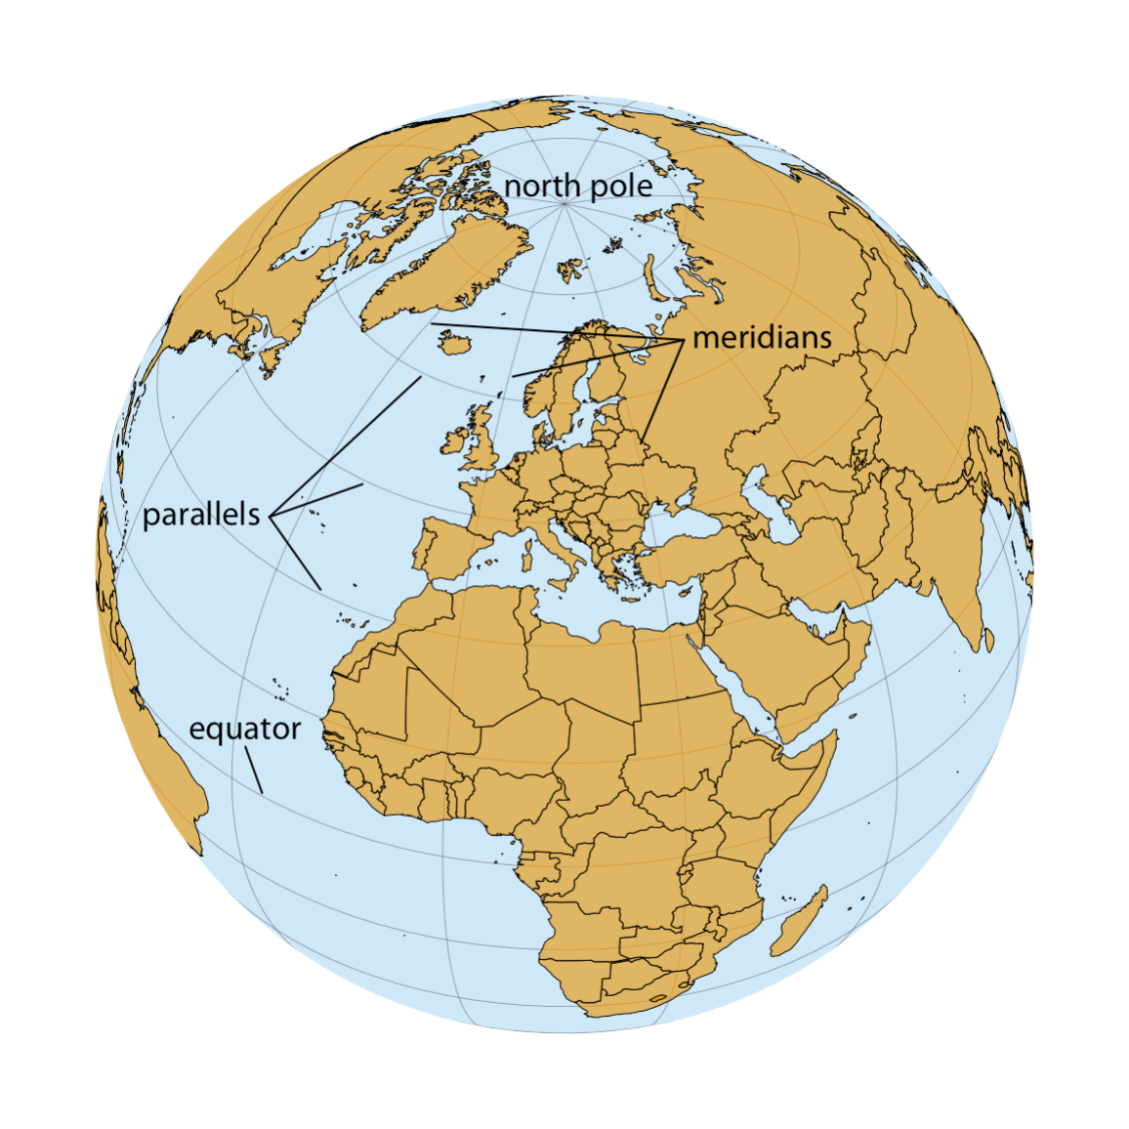
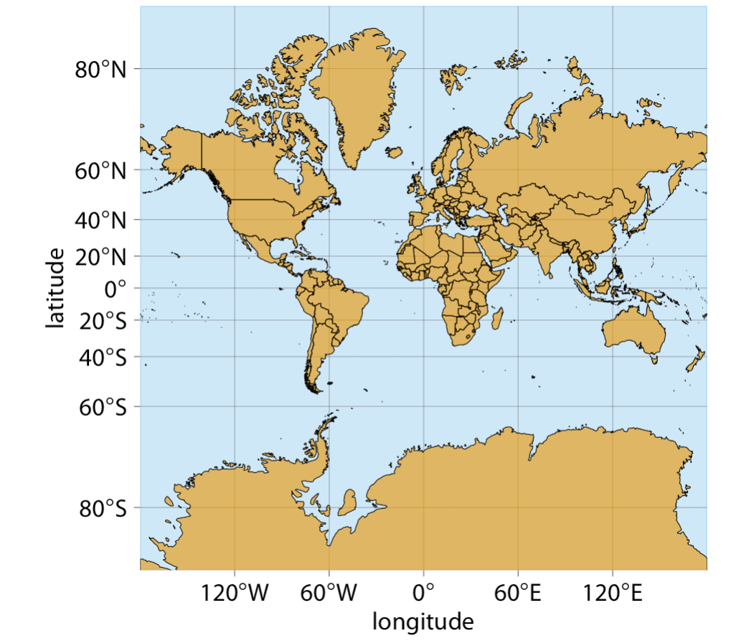
Visualizing Geospatial Data

Slide 3
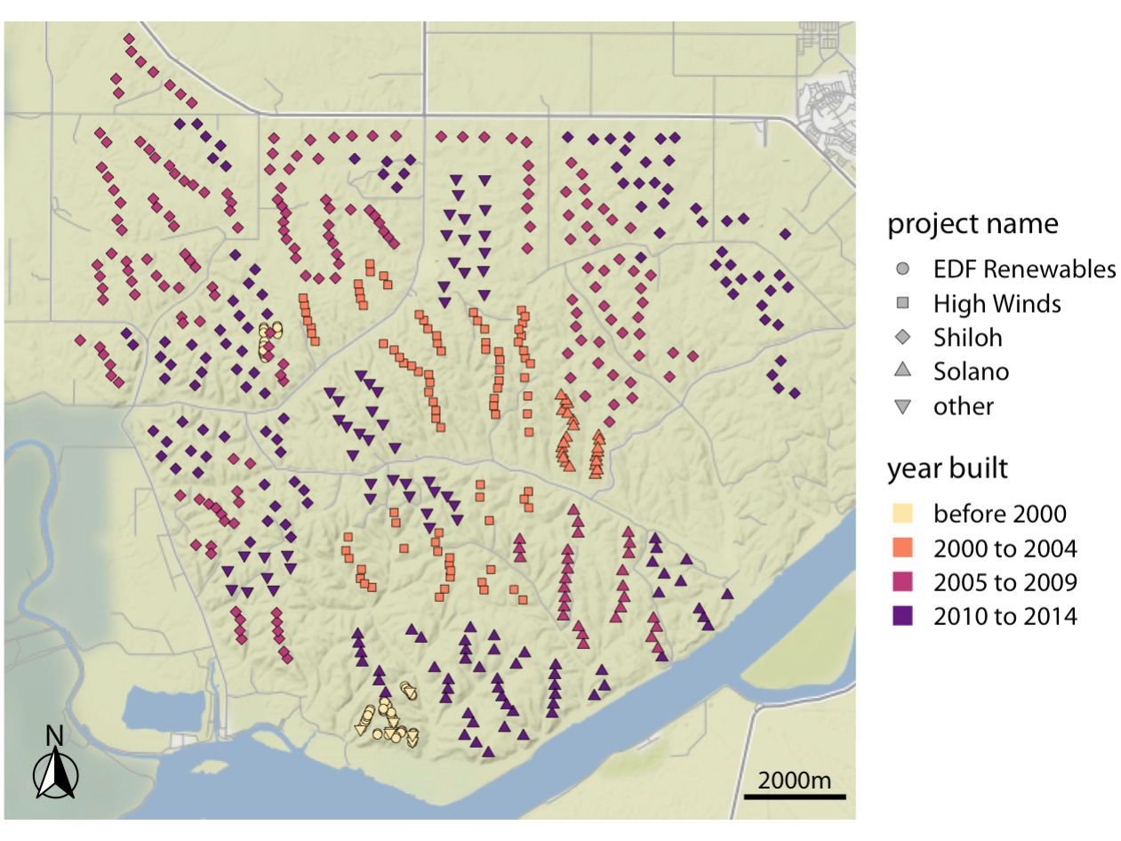
Data labelling with Geo-Spatial

Slide 4
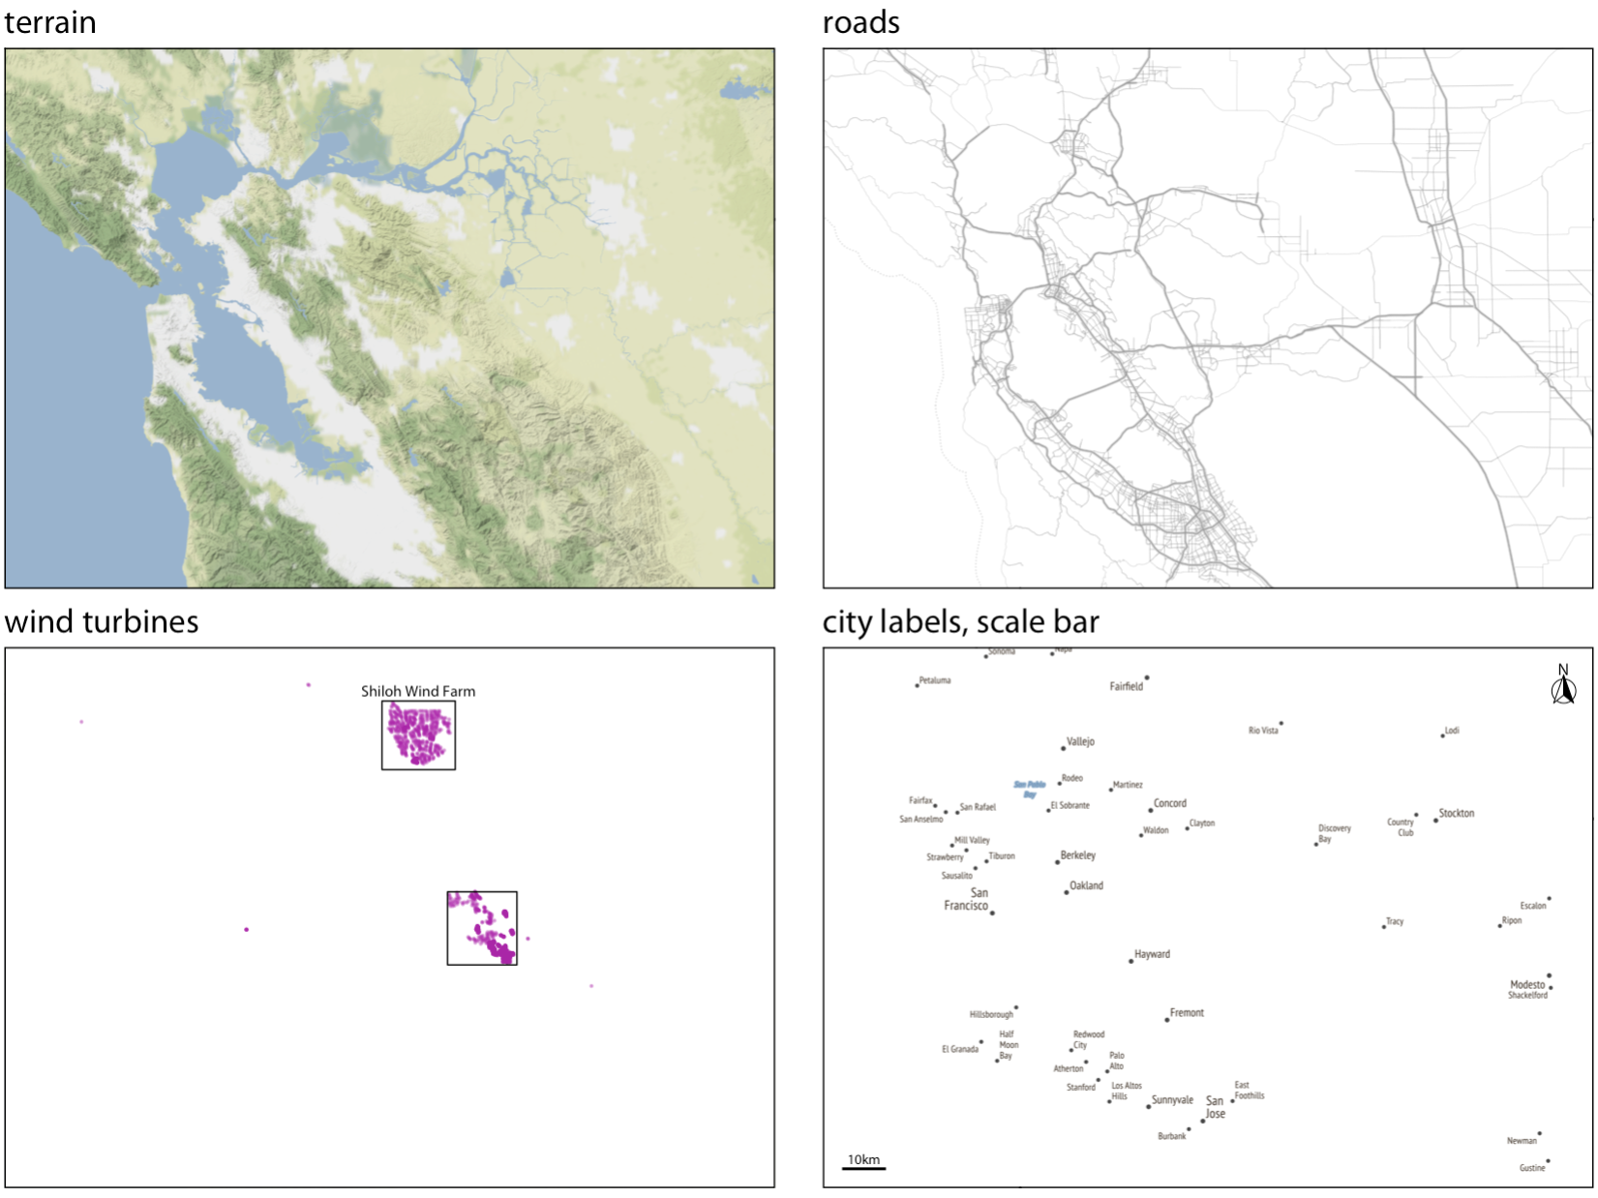
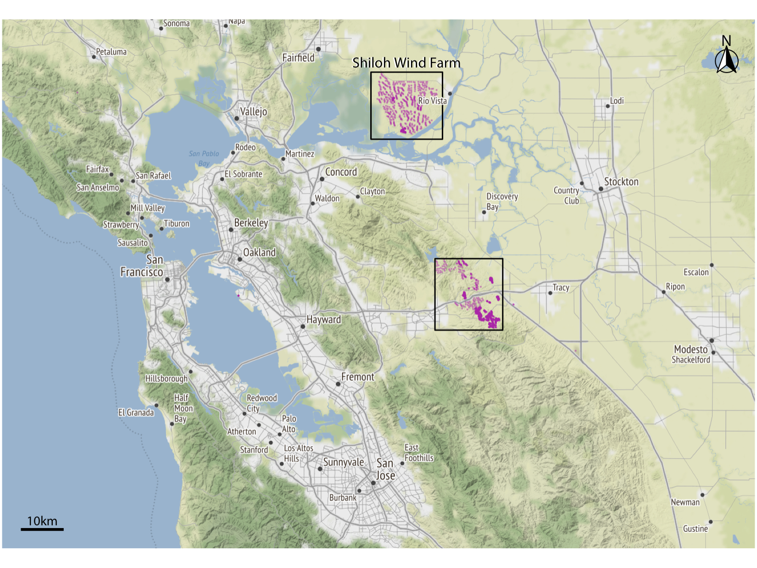
Layers

Slide 5
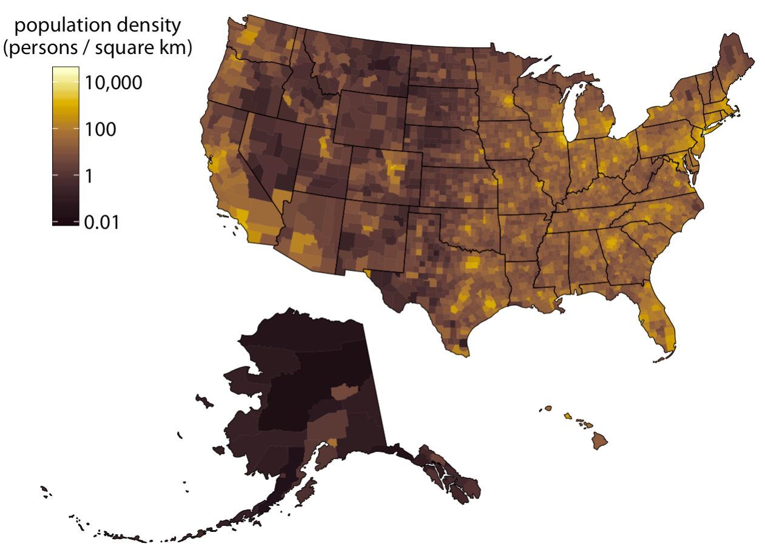
Choropleth Mapping
Showing quantitative data with specific colors.
Same as that of heat map

Slide 6
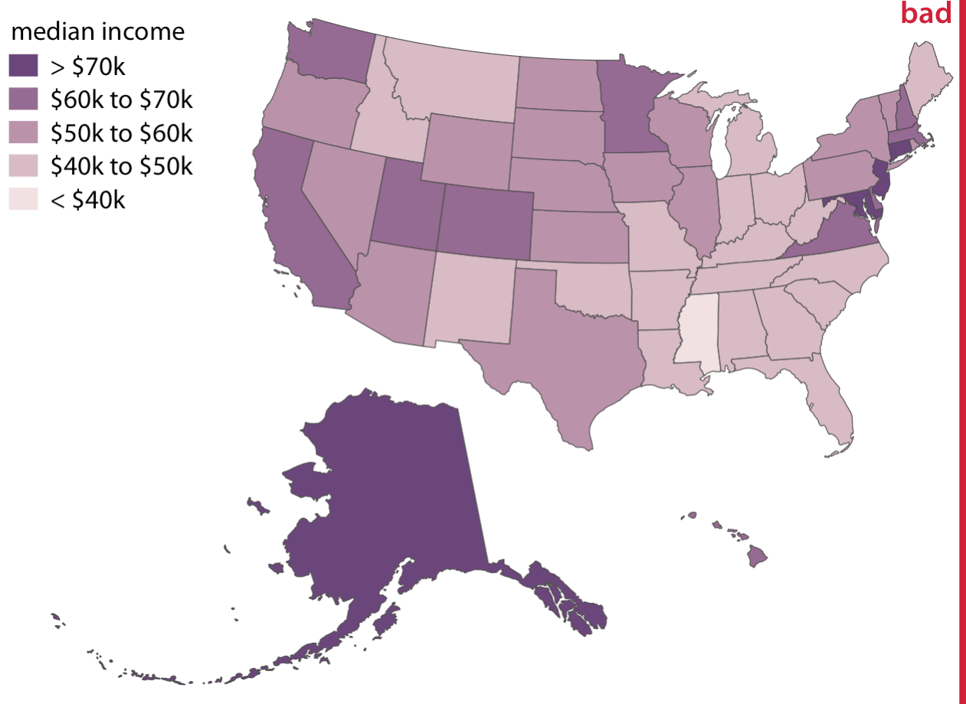
Choropleth Mapping
Showing quantitative data with specific colors.
Same as that of heat map

Slide 7
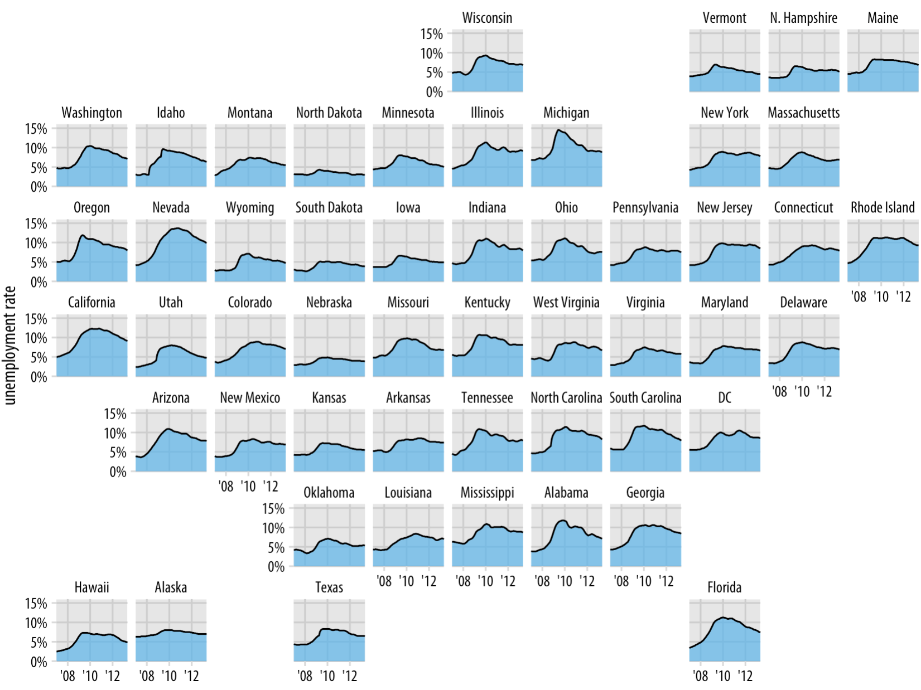
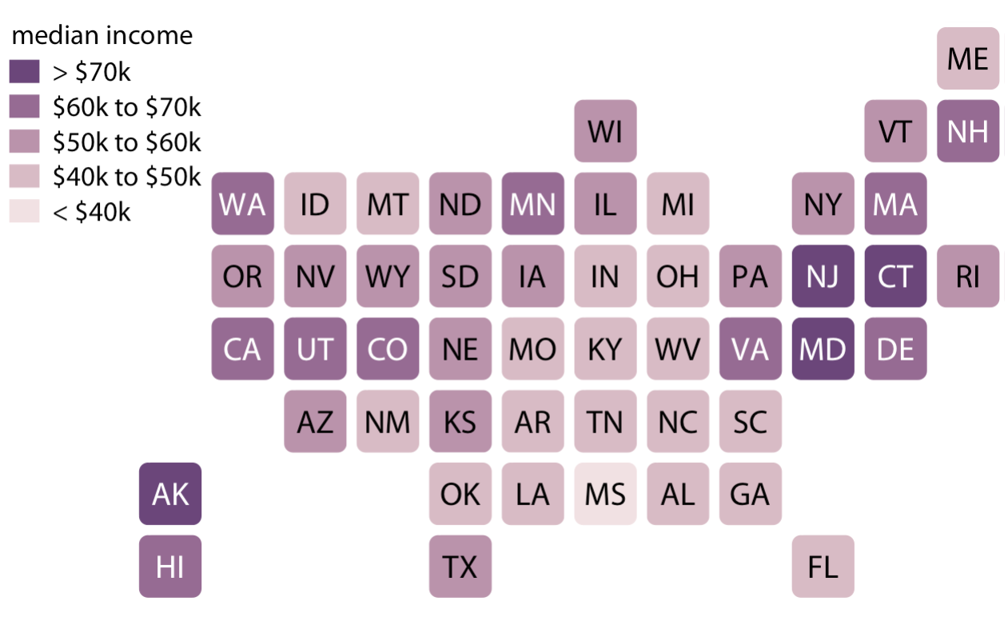
Cartograms

Slide 8
Visualizing Uncertainty
Graphical representation of uncertainty or variability in data or predictions.
It is a technique used to convey the level of confidence or range of possible outcomes associated with a particular data point or estimate.
Different ways to represent Uncertainty
Error Bars:
Confidence Intervals:
Probability Density Plots:

Slide 9
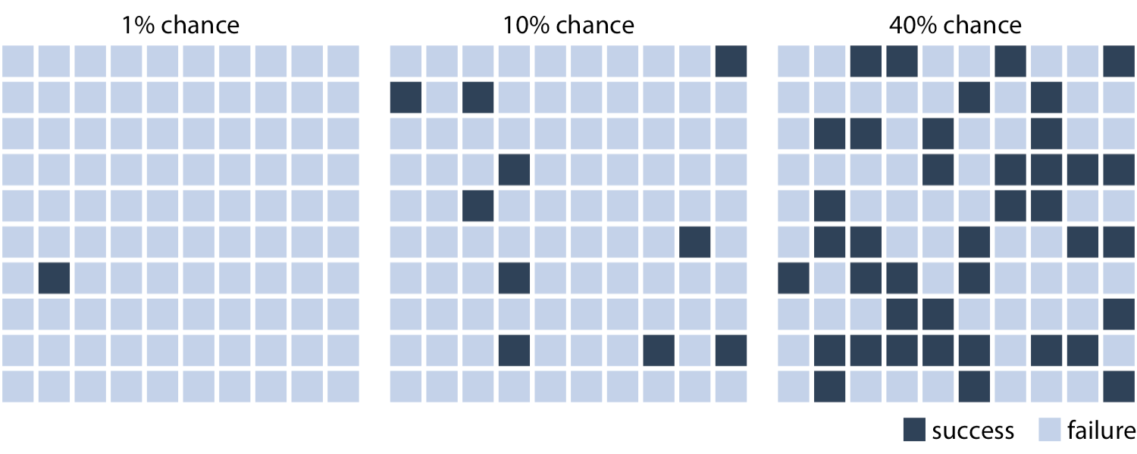
Basic’s of Uncertainty with probability

Slide 10
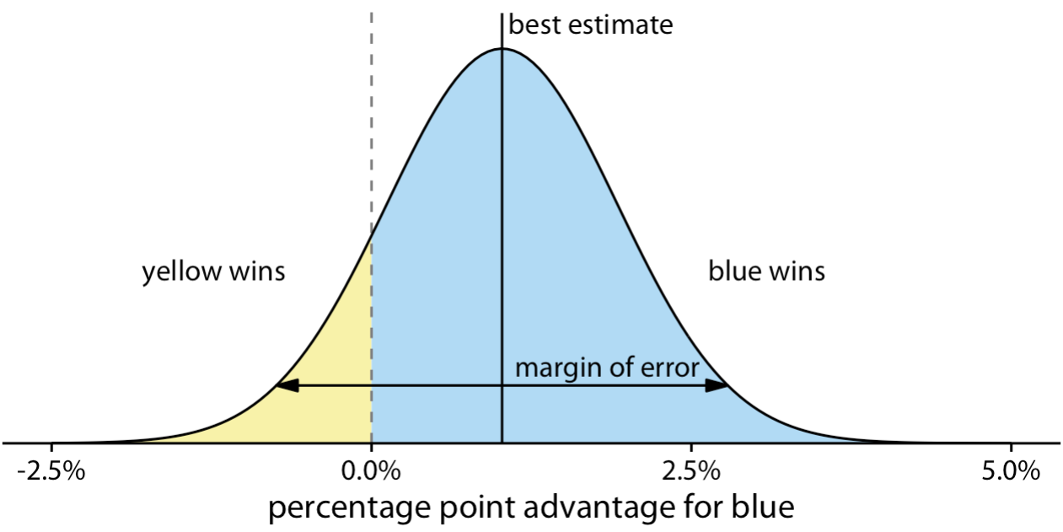
Confidence interval

Slide 11
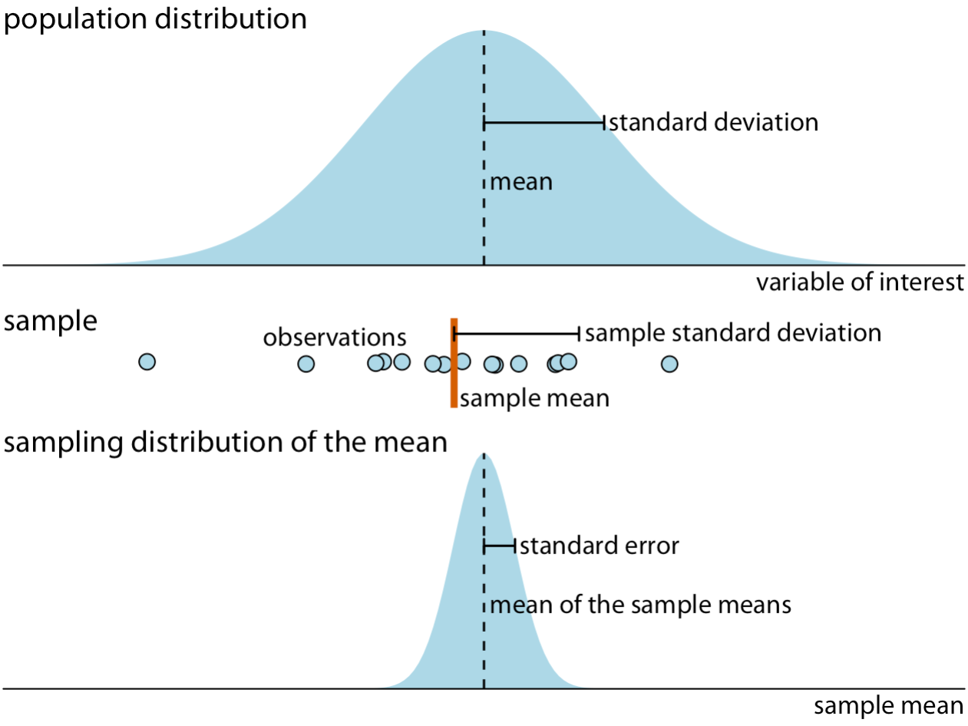
Visualizing the Uncertainty of Point Estimates

Slide 12
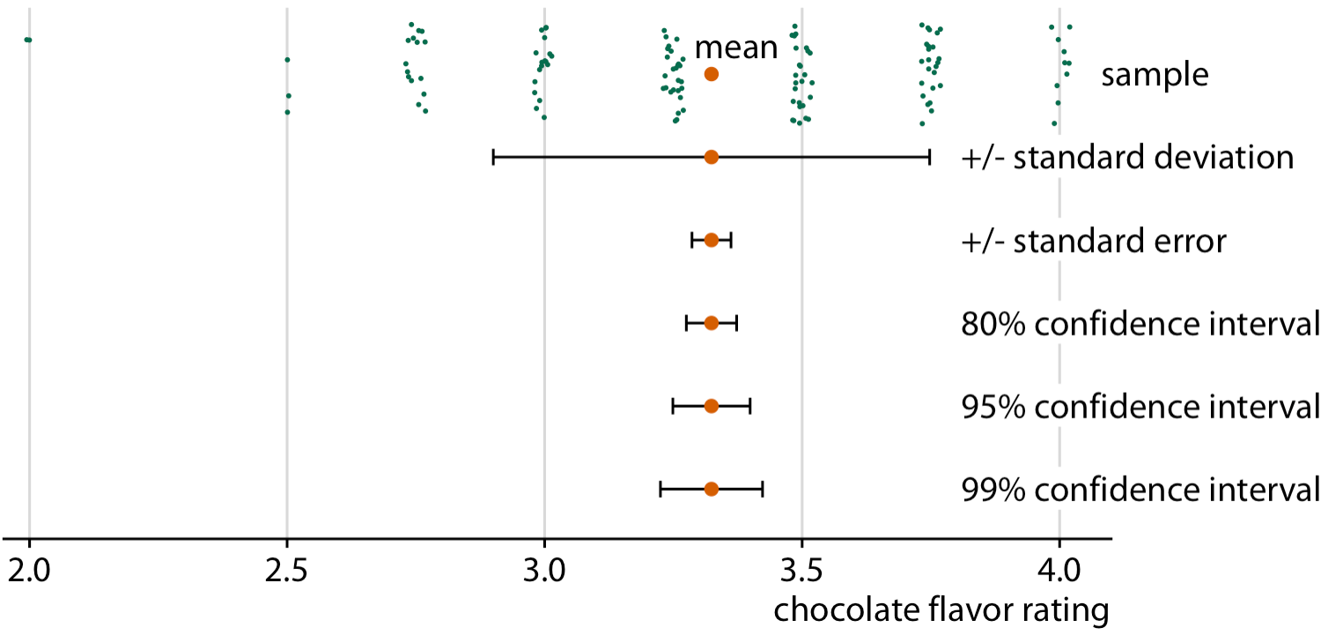
Visualizing the Uncertainty of Point Estimates

Slide 13
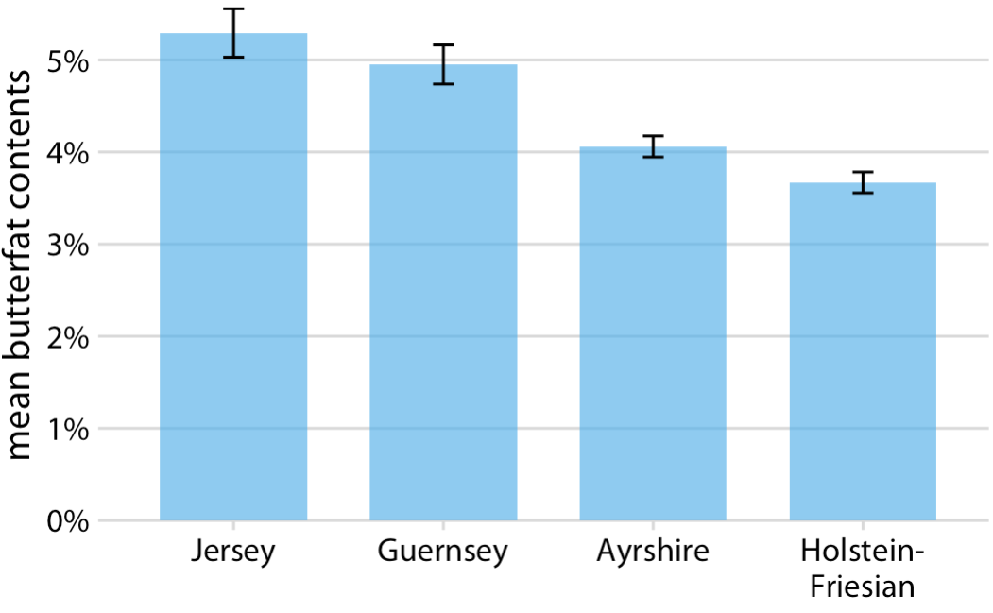
Error Bars
Mean butterfat contents in the milk of four cattle breeds.

Slide 14
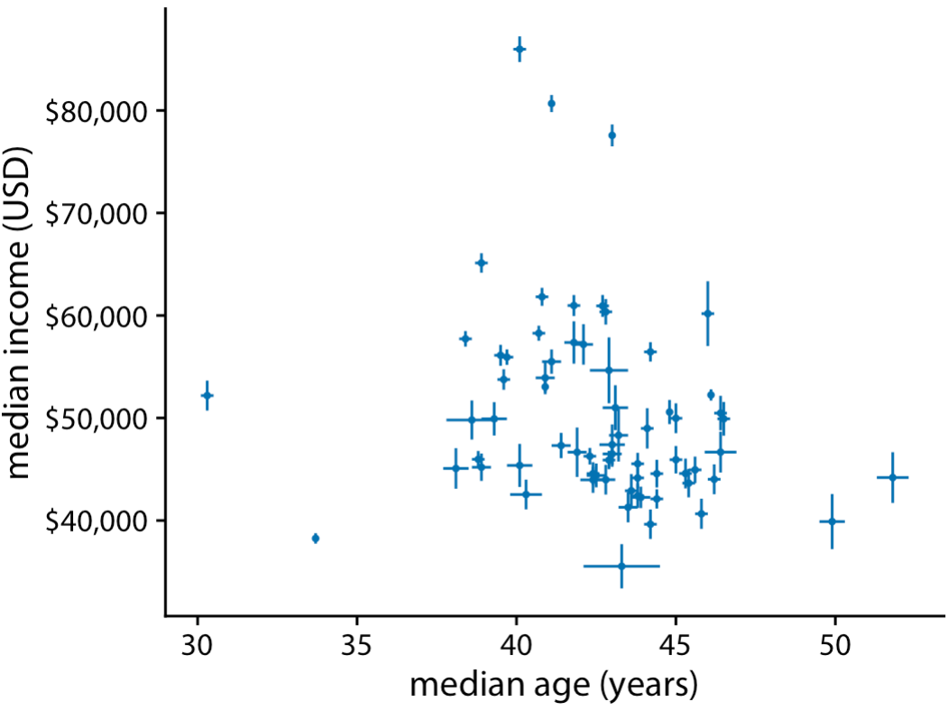
Error Bars
Median income versus median age for 67 counties in Pennsylvania

Slide 15
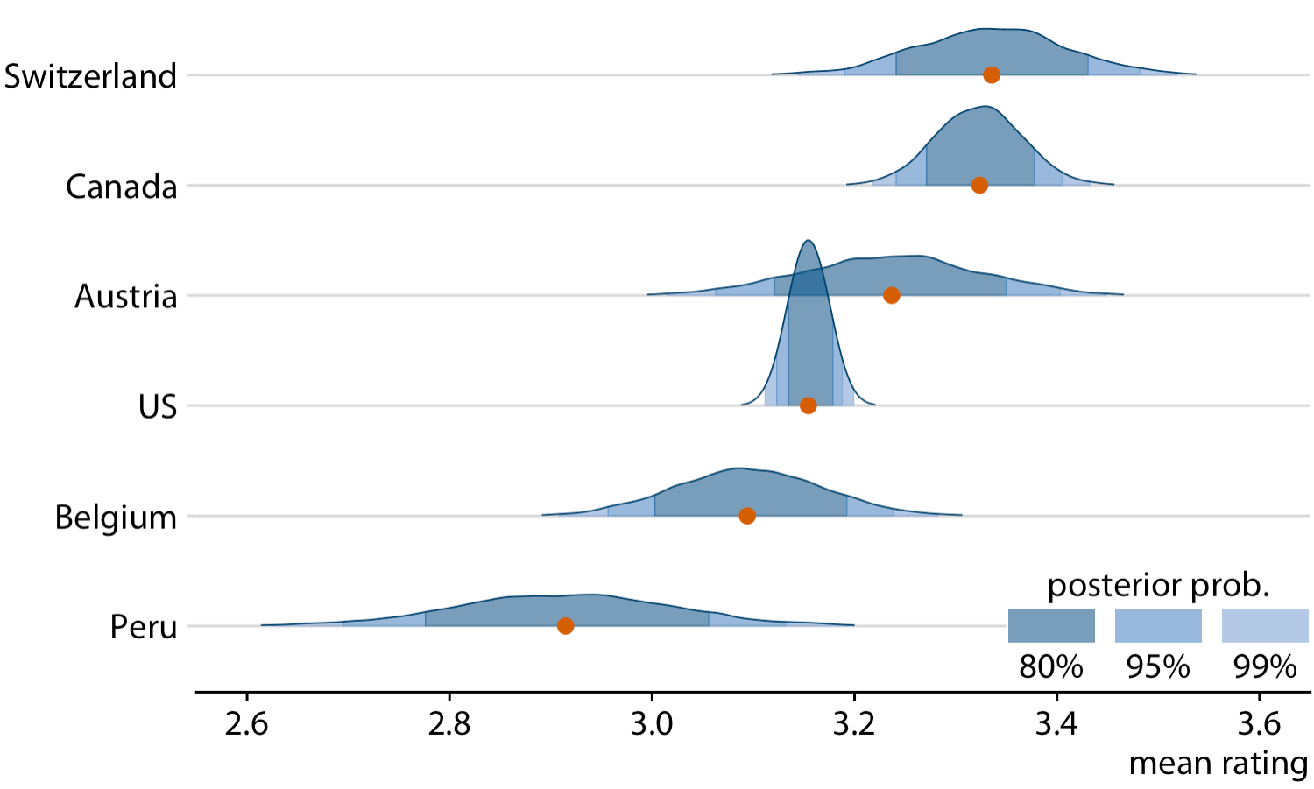
Probabilities/distributions
Bayesian posterior distributions of mean chocolate bar ratings, shown as a
ridgeline plot.

Slide 16
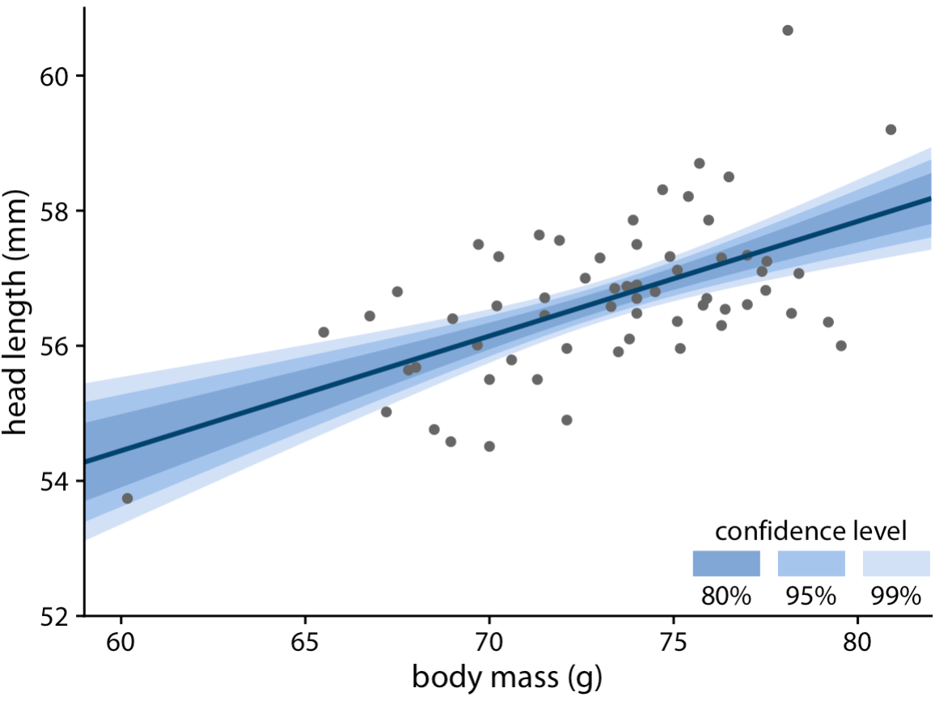
Visualizing the Uncertainty of Curve Fits

Slide 17
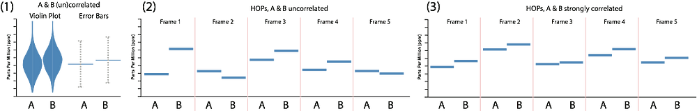
Hypothetical Outcome Plots

